Slide 1






Group 1
Brett Adams
Tanvir Hossain
AMII Students Spring 2023 Session
Ram Dershan
Cailenys Leslie
Clinton Boyda
Notes:
CAILENYS
This presentation encapsulate 9 intense weeks of a journey undertaken by a team of 5 motivated individuals, who were eager to go above and beyond to become Machine Learning Technicians.

Slide 2


AMII Machine Learning Technician
Group 1 Capstone Presentation
Landlord
Smart
Pricing
March 31, 2023

Slide 3

Project Objective
Find the best machine learning model that predicts the optimal price of a rental property to maximize revenue.

Slide 4

Business Case
Attract more Airbnb hosts and help them decide whether to invest in a property.
Success Criteria
Coefficient of
determination (R²) ≅ 1
A
Mean squared
error (MSE) ≅ 0
B
C
Notes:
Cailenys:
Host pricing optimization = improve revenue for Airbnb
The real rental price and the features in our DataFrame were based on historical Airbnb data from NYC (2019) and obtained from a public source known as Kaggle

Slide 5

Data Science Life Cycle
1 Data Collection
3 Data Visualization
5 Model Evaluation
2 Data Preprocessing
4 Model Building
Exploratory Data Analysis
Notes:
BRETT
First, we began with exploring our dataset to begin assessing our defined business case.

Slide 6
Data Collection
1.0 Merging Data
Original Data
49k records
Limited features
Additional Data
42k records
+ new features
Merged Data
16k records
8 features
Notes:
BRETT
The original dataset from kaggle fundamentally associated the value of a property with the location, but does not contain the full suite of features that people use when they assess whether or not they would like to book a specific AirBnB
If you’re planning a group trip for example with 6 people, you would need to know:
Bathrooms
Bedrooms
# number of people the space could accommodate etc.
We knew that in order for a human to make an informed decision on whether or not the listing is worth the price per night the original dataset listed it as, we searched to see if an accompanying dataset existed to enhance the original
Our search was successful! We were able to locate a dataset in which shared a unique feature and contained the features we knew in real life would influence the price of a listing
After the merge, 16k of the original examples were present in the additional dataset

Slide 7
Data Science Life Cycle
1 Data Collection
3 Data Visualization
5 Model Evaluation
2 Data Preprocessing
4 Model Building
Feature Engineering
Notes:
BRETT
With our new, enhanced dataset, we moved on to preprocessing this data

Slide 8
Data Preprocessing
2.0 Keep only Valid Data
x Zero Price
x Zero Availability
x Extreme Values
Merged Data
16k records
InValid Data
8k records
Valid Data
8k records
8 features
Notes:
BRETT
After the merge we carefully assessed and examined our new dataset for invalid values or values that didn’t make sense so that we could update or remove them to enhance the quality of our data
For example, there were listings in which were available 0 days of the year, or listings for free which would not aide our predictions later on
Next, we improved our dataset by cleaning our features

Slide 9
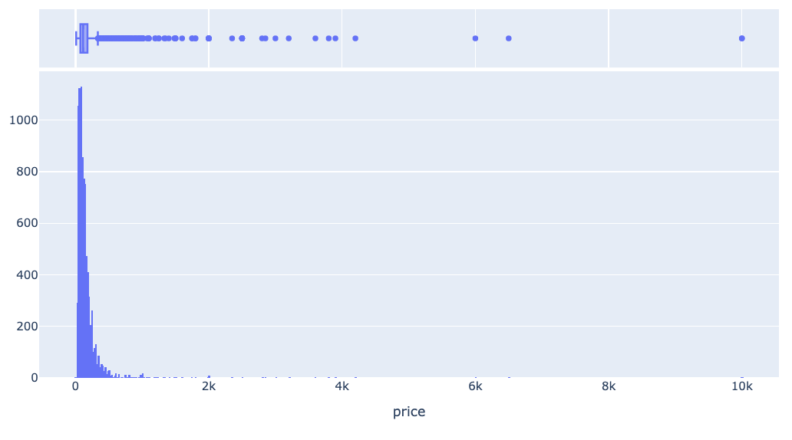
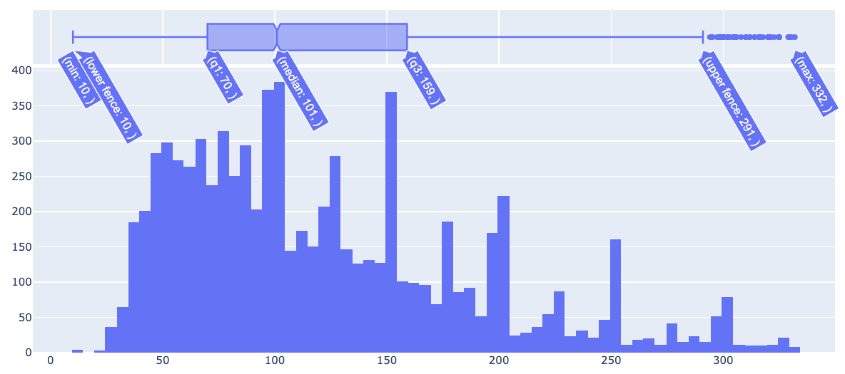
Data Cleaning
2.1 Extreme Values
count
Original Distribution by Price
Cleaned Distribution by Price Comparison
Notes:
BRETT
With proper data cleaning, we are able to set our model up with the highest chance of maximizing accuracy during the modeling phase
One aspect of data cleaning we applied in our project was the assessment and removal of extreme values
For example, extreme values exist in the price feature, with some units charging more than $2k dollars per night.
When plotted, this feature is highly skewed and we can’t clearly see the median or box plot values
We can see that although there are only a few extreme price values, these could really distort our machine learning models.
Once we remove those outliers we can see a much more tightly grouped listing of prices that could easily become a gaussian (normal curve) with the log function, which we applied in later steps.
And now we move on to the next stage of the machine learning process which Clinton will explain.

Slide 10
Data Science Life Cycle
1 Data Collection
3 Data Visualization
5 Model Evaluation
2 Data Preprocessing
4 Model Building
Feature Correlation
Notes:
CLINTON
Now that we have cleaned our data, our visualizations will showcase our data better

Slide 11
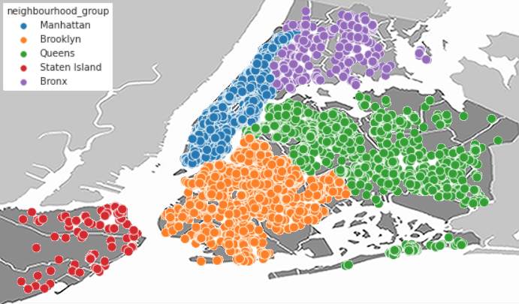
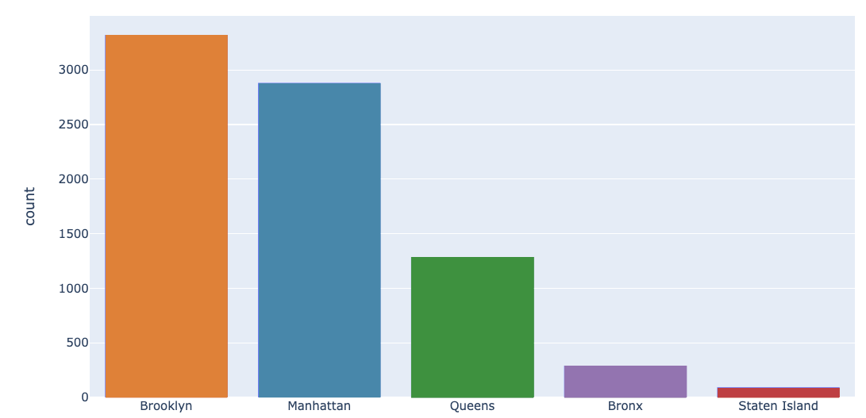
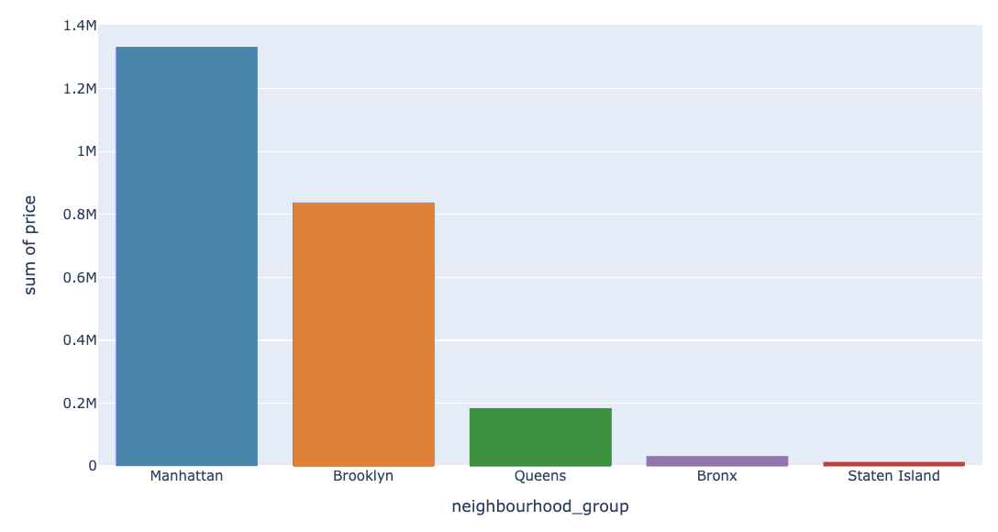
Data Exploration
3.0 Neighbourhood Locations
Notes:
CLINTON
INTUITIVE UpperRight: Can see our 5 neighbourhood groups on a map of NYC
Looking at the count of properties by location
While Brooklyn has the highest NUMBER of listings, actually Manhattan has the highest sum of unit pricing
So this beckons the question: What does relate to price?

Slide 12
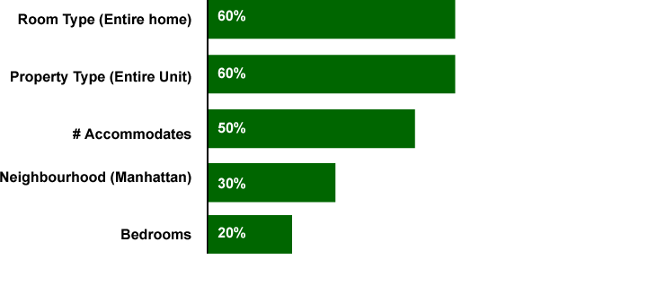

Data Visualizations
3.1 Correlations with Price
Property Type (Entire Unit)
Room Type (Entire Home)
# Accommodates
Neighbourhood (Manhattan)
Bedrooms
Notes:
CLINTON
Reviewing the statistical correlations we can see ROOM TYPE and PROPERTY TYPE correlate the highest with 60% to price, while our neighbourhood is actually only at 30%

Slide 13
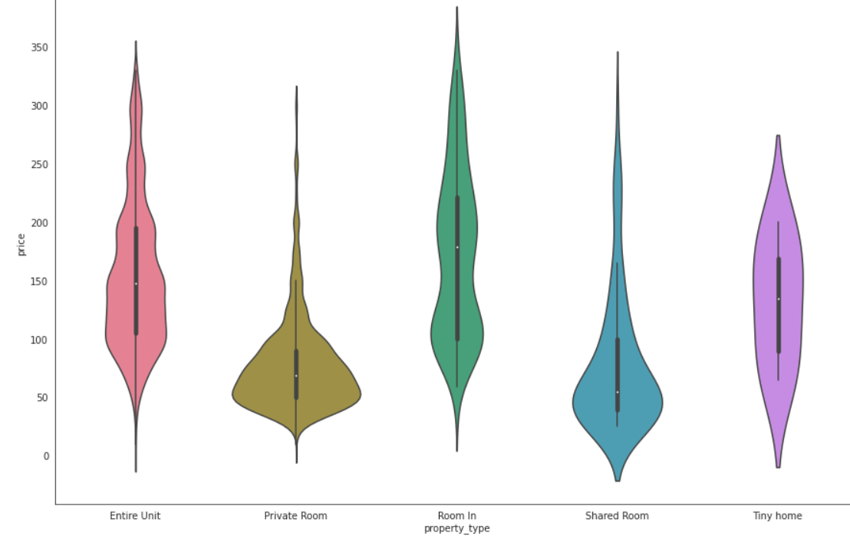
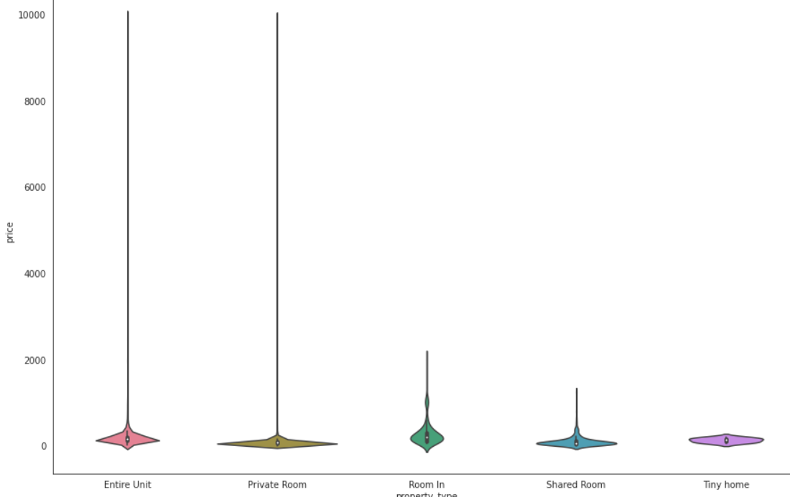
Data Visualization
3.2 Property vs Pricing
$300
Notes:
CLINTON
Benefits of removing extreme values also includes trimming the price to provide better visualizations
This example showcases price by neighbourhood density and distribution
A host can now compare where their $250 unit would compare to similar units in each of the neighbourhoods

Slide 14
Data Science Life Cycle
1 Data Collection
3 Data Visualization
5 Model Evaluation
2 Data Preprocessing
4 Model Building
Regression
Notes:
Now let us talk about the design flow of the machine learning model building.

Slide 15



4.0 Model Building
Feature selection
Model Pipeline
Performance evaluation
4.1
4.3
4.2
Notes:
It contains 3 different steps: model pipeline , feature selection and performance evaluation.
I will guide you through each steps one by one in the following few slides.

Slide 16
4.1 Model Pipeline
Data insertion
Feature Transformation
ML selection and training
Performance evaluation
Notes:
A machine learning pipeline is a way to codify and automate the workflow it takes to produce a machine learning model.
At the first stage clean data enter into the pipeline.
In the second stage it Transforms features based on their data types. All types of feature scaling and encoding are performed in this stage.
During the third stage transformed data trained with different machine learning model.
And finally, all models performances are evaluated. Based on this initial performance,another feature engineering performed on the dataset and start from feature transformation. It is a CI/CD process to get the best model accuracy.

Slide 17
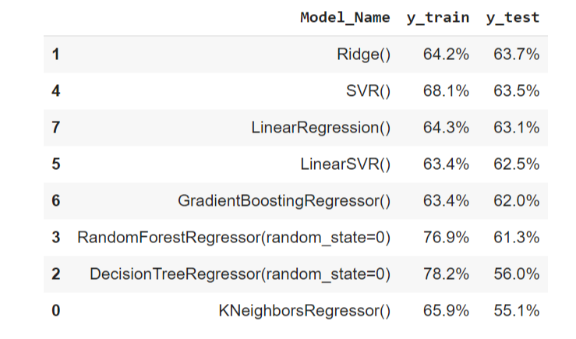
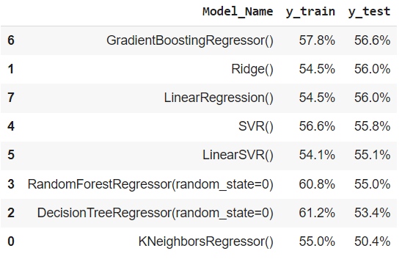
4.2 Feature selection
Before feature selection
After feature selection
Notes:
Initially we use our clean data , use different models to train our data then get the model accuracy for each model showed on the table at your left. Form here, it is visible that our model accuracy is good for trained data but not for test data. That says our model is a overfitted model and raise the importance of feature selection.
To overcome this problem, we have to remove some features that are not statistically significant and train them again with the same models. The outcome listed on the right side table where it shows that we are able to get rid of the overfitting problem and get and overall generalized model.

Slide 18
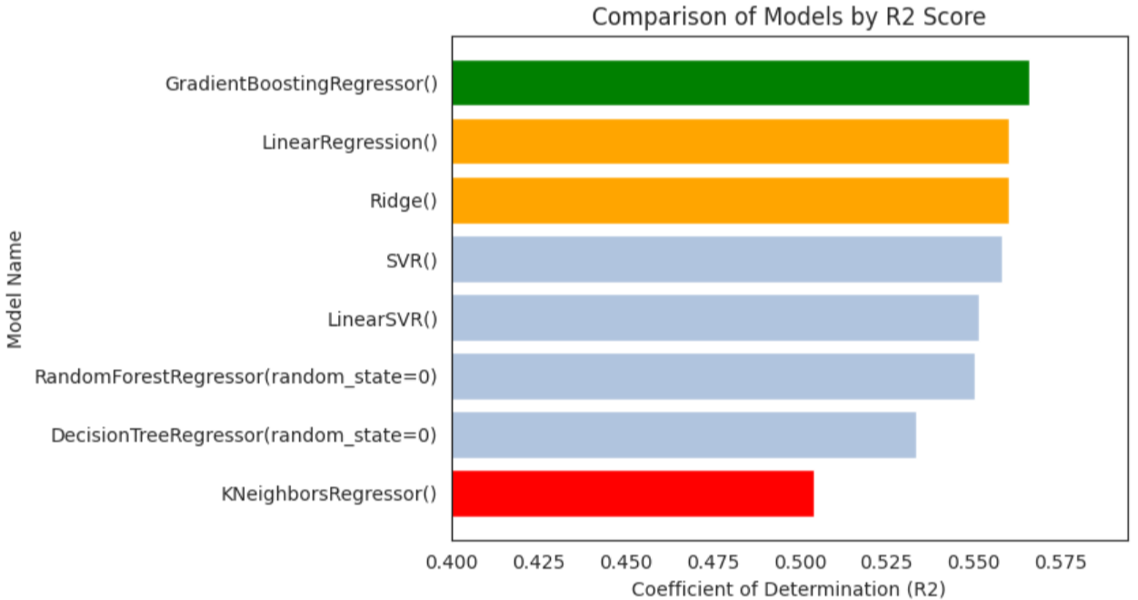
4.3 Performance evaluation
Notes:
The bar plot here shows R2 score for each model. Based on the r2 score our best model is Gradient boosting regression model shows by the green bar.
The 2nd and 3rd best models are Linear and Ridge regression model shows by the yellow bar. It’s worth to mention that the R2 score of this two models are very close to each other.
The worst model in our case is the KNNregression model shows by the red bar..

Slide 19
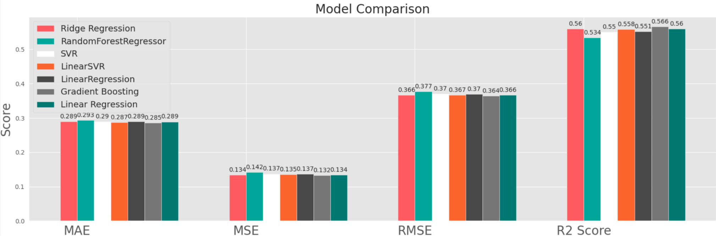
4.3 Performance evaluation
Notes:
In this plot we shows some other Coefficient of determination metrics that are used to evaluate the performance of our model. In all cases, Gradient boost regression model are outperformed compared to other models showed by the gray color bar.

Slide 20
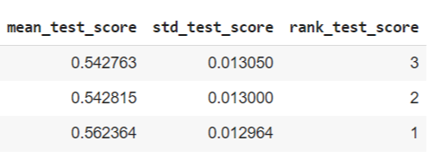
4.3 Performance evaluation
Linear regression
Ridge regression
Gradient boosting regressor
Minimal improvements with hyperparameter tuning.
Notes:
Then we took our top 3 model, ridge , linear and gradient boost regression model and used GridsearchCV that is a process of performing hyperparameter tuning in order to determine the optimal values for a given model.
In the table, all the test scores are shown. Even after the hyperparameter tuning we noticed minimal improvement of our model and gradient boosting still comes as the top performed model.
Now my colleague RAM will guide you through the model evaluation and limitations.

Slide 21
Data Science Life Cycle
1 Data Collection
3 Data Visualization
5 Model Evaluation
2 Data Preprocessing
4 Model Building
Accuracy
Notes:
RAM

Slide 22
Model Evaluation
5.0 Performance Results
Model Name
Accuracy
Ridge Regression
56%
Notes:
RAM

Slide 23
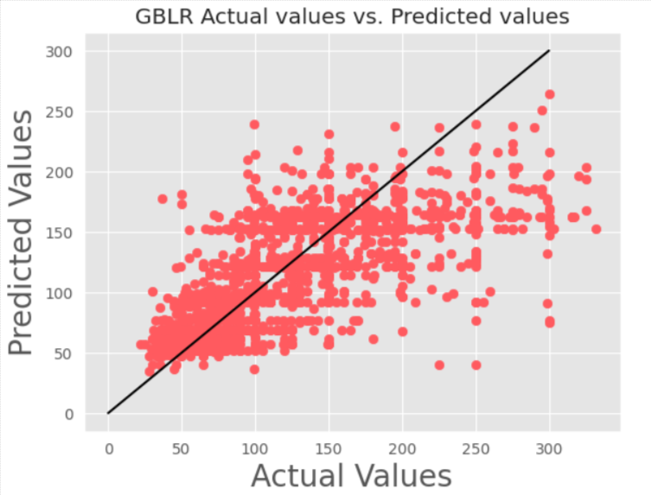
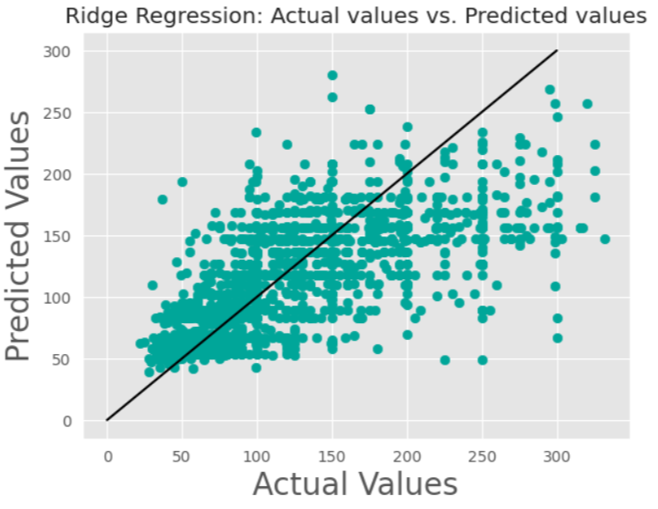
Model Evaluation
5.1 Actual vs Predicted
Notes:
RAM

Slide 24
Wrap-up: Analysis Limitations
1
Regionally Specific
3
Sampling bias
2
Trendline have limitation
4
Limited variables
Notes:
RAM:
Regionally specific information may not correlate well other locations (cities), less accurate in LA vs NY.
Only looking at data from one year (2019)
The dataset had more properties in one neighbourhood than other neighbourhoods .
Our analysis only included price and property details, not how OFTEN a place was rented. Popularity Unknown (only # of reviews vs times rented).

Slide 25

Potential Enhancements
Include additional Features
Pursue Additional ML Models
Expand Profit Prediction Potential
1
2
3
Notes:
CAILENYS
More correlated Features == Better Price Predictions
SVR +1% accuracy
Full accounting forecasts are ONLY possible with both INCOME and EXPENSE (missing)
ARR = Annual Recurring Revenue (we need expenses and vacancy information to calculate/predict)

Slide 26
Business Summary:
1
Smart Pricing Improvement
2
Pilot Program
Landlord
Smart
Pricing
3
Uber Surge Pricing Equivalencies
Notes:
BRETT
Now that Cailenys has explained how would could enhance our project, I would like to talk about where could these enhancements lead us and improve our business case.
Ultimately this is an exercise in improving AirBnB’s Smart Pricing feature which is a setting a host can toggle to allow AirBnB to recommend or set the price for you.
AirBnB could launch a pilot program where a host gives AirBnB access to additional information such as:
Mortgage payments amounts
Desired margin % that you would like
With this information for the cost side of the revenue equation, AirBnb would have access to additional, high quality features for the ML model which can give the host a better price recommendation.
The model could correlate certain amenities with higher prices (parking, air conditioning in the summer) which could assist hosts in prioritizing upgrades to their space
The mode could also suggest that you consider changing certain inputs, such as whether or not you want to charge a cleaning fee, or if you should consider not splitting the fee’s with your guests.
These prompts could be accompanied with data-driven insights presenting the host with potential profit increases should they opt-in to the recommendations given
This is even more powerful at scale for those with more than one unit, property management companies, or hotels who could average the revenue over multiple units.
Translation: higher price accuracy = happier hosts = higher likelihood more hosts join AirBnB = higher profits for AirBnB
Lastly, to improve the demand assumptions, AirBnB should strive to emulate Uber’s surge pricing feature.
If the SmartPricing feature can better capture events taking place in your area, or seasonal price fluctuations for the market in general, then this would allow the host to properly increase the price to take advantage of high-demand times.
Better capturing demand allows for the host to lower the price in lower demand times. Then the model can capture this change and reflect that for the yearly financial predictions on a dashboard.

Slide 27
Questions?

Slide 28
Optimal Model Selection
ML Insights
Merged
65%
Merged
Features
RECORDS: ~8k FEATURES: 8
Original
59%
Original
Features
RECORDS: ~28k FEATURES: 4

Slide 29
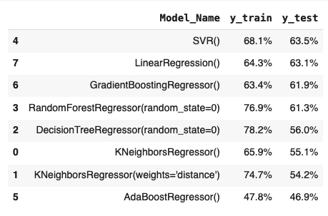
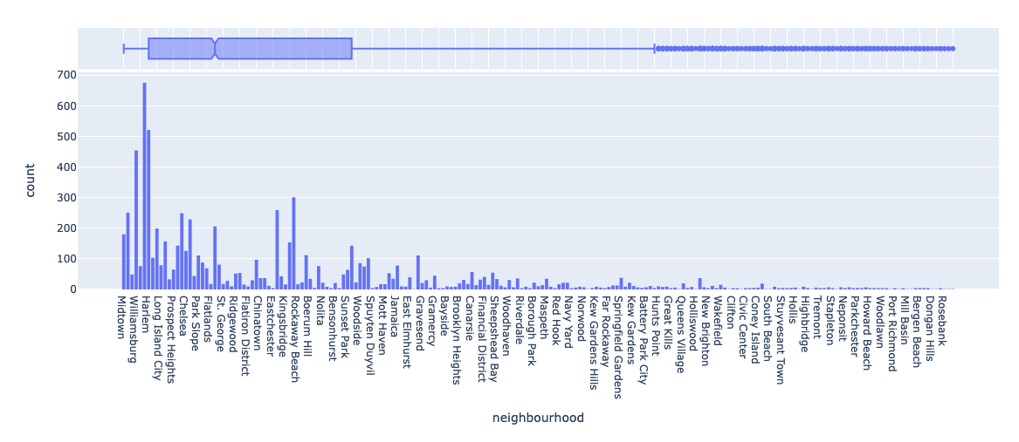
Pipeline Result with Neighbourhood feature
Notes:
Discussion of whether dropping neighbourhoods was necessary

